Slide 1

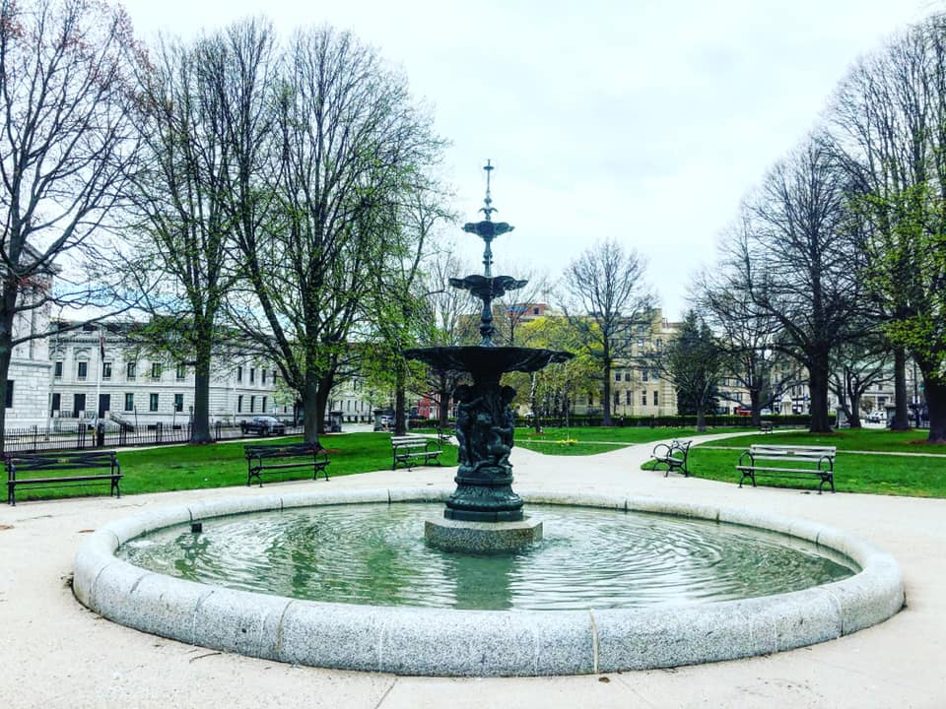
Maine Bar Examination
Application Process
Photo Courtesy of Kelly Watters

Slide 2
Housekeeping Items:
Questions about your individual application should be sent to our office through the applicant portal
If you need additional information, please review our website. If your question is not addressed on our website, please ask our office directly rather than relying on a third party

Slide 3
Applying for the Maine Bar Examination

Slide 4
Bar Exam – Application Deadlines
In accordance with Maine Bar Admissions Rule 5, the deadlines for each exam are listed below:
  (1) For the February examination, between the preceding October 15 and the preceding December 20.
  (2) For the July examination, between the preceding March 15 and the preceding May 20.

Slide 5
Different Types of Bar Exam Applications
There are three (3) different types of Applications that can be submitted for the Maine Bar Exam:
        Applicant Not Admitted In Another Jurisdiction for a Year or More;
        Applicant Admitted In Another Jurisdiction for a Year or More;
        Re-Application.

Slide 6
Applicant Not Admitted In Another Jurisdiction for A Year Or More
An applicant would complete this application if:
      The applicant is not admitted to another jurisdiction for a year or more; and
      The applicant is seeking admission to the Maine Bar.

Slide 7
Applicant Admitted In Another Jurisdiction for a Year or More
An applicant would complete this application if:
      The applicant is admitted to another jurisdiction for a year or more; and
      The applicant is seeking admission to the Maine Bar
*In addition to this application, the applicant must also complete the NCBE Application. Information regarding the NCBE application is located on our website.*

Slide 8
Re-Application
An applicant would complete this application if:
  The applicant has previously applied for the Maine Bar Exam;
  Is seeking admission to the Maine Bar; and
  Has previously completed a full application through the applicant portal.
  *This application should not be completed by applicants re-applying for the exam who are not seeking admission to the Maine Bar (Courtesy Seat applicants).*

Slide 9
Bar Examination Dates
The Board shall administer the Maine bar examination twice a year, in February on the last Wednesday and the preceding Tuesday, and in July on the last Wednesday and the preceding Tuesday.
        Day 1: MPT (morning), MEE (afternoon)
        Day 2: MBE (all day)

Slide 10
Pandemic Requirements
Since the beginning of the COVID-19 pandemic, the Board has continuously assessed the health recommendations made by the Maine Center for Disease Control and the United States Center for Disease Control.
In order to keep all individuals involved with the administration of the examination safe, the Board has previously required the following at each exam:
  Screening and symptom checks to enter exam rooms – conducted in Medical Room
      Temperature Checks
      COVID Screening Questions asked by medical professional
  Masks worn inside the exam room and venue at all times
  Applicants must disclose to Maine Board of Bar Examiners immediately if they test positive for COVID within two-week period post exam

Slide 11
Bar Exam Safety Plan
Code of Conduct
  Old: Take your exam with honesty, integrity and respect for others
  New: Honesty, integrity and respect for others along with compliance with health and safety requirements
This should go without saying, do your best to minimize your risk of exposure to COVID-19 and other illnesses prior to and during the exam by wearing masks, distancing and complying with the State of Maine quarantine requirements.

Slide 12
Location of Exam
Venue:
          DoubleTree Hotel (363 Maine Mall Road, South Portland, ME 04106)
          The hotel will create a group block for applicants prior to the exam. This information will be provided by MBBE staff on the Announcements page in the applicant portal prior to each exam

Slide 13
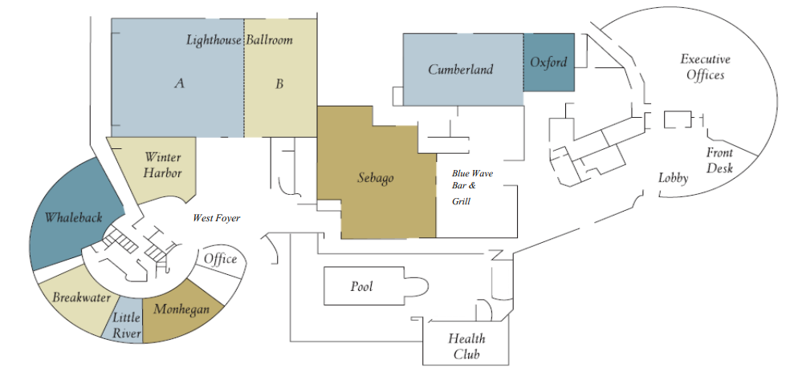
DoubleTree Hotel – South Portland, Maine
*
*
*
*
*
*
*
*
*
Entrance
*Exam Rooms*

Slide 14
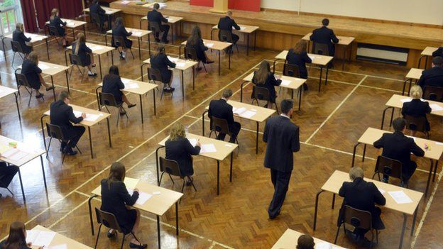
IN THE ROOM
Assigned seats, clearly marked
Forward facing
Clock to keep time
15-minute warnings
RESTROOMS
One at a time per designated restroom
One person in the hall at a time
Hall monitors to manage movement
Restroom log
MONITORS
Masks
Screening, symptom & temperature checks (conducted by medical professionals)
HEALTH EMERGENCY
Notify the monitor
Close and collect your laptop
All paper in plastic bag, leave with monitor
Writing and cleaning materials stay on desk
Pick up your extra possessions
Hall monitor will take you to separate room
No returning to the exam

Slide 15
Items Required at Your Seat:
Photo Identification
Properly worn face mask provided by the Board each session (if required)
Applicant number card (supplied by the Board)
Seating card (supplied by the Board)
NCBE number card (supplied by the Board on Day 2)
Pens with blue or black ink and/or #2 pencils
#2 pencils

Slide 16
Permitted but Optional:
Tissues (provided by the Board on both days)
Clear, non-alcoholic beverage in a clear container with a closeable cover/lid
Eyeglasses (without a case)
Eye drops
Ear plugs (provided by the Board)
Non-hooded sweater or sweatshirt (room temperatures may vary; dressing in layers is recommended)

Slide 17
What NOT to bring to the exam:
Food to be consumed during the exam (you are encouraged to bring lunch and/or snacks for consuming during lunch break-outside of exam room)
  please refer to the Medical Alert Form to notify the Board if an accommodation is needed
Hats, hooded sweatshirts or sweaters, or similar head gear; multi-pocketed clothing, outerwear
  Religious clothing, headwear, and/or traditional dress may be worn but is subject to inspection; prior notice to Executive Director is required
External mouse or keyboard
Personal flash drives
Retractable pens
Tobacco/Vape products

Slide 18
Items not allowed in exam room:
  Cell Phones/Smartphones/Tablets (can leave in secured location at registration area with monitor – will not have access to cell phone until end of day)
  iPods
  Any two-way communication and/or similar electronic communication devices

Slide 19
What we provide:
  Power at your seat for your laptop
  Writing implements if needed (you may bring your own)
    Tuesday: non-retractable pens & pre-sharpened #2 pencils
    Wednesday: pre-sharpened #2 pencils
  Scrap paper (Day 1 only)
  Tissues
  Surgical-style masks
  Your applicant number, seat assignment and NCBE numbers
  Extegrity laptop instructions

Slide 20
Extegrity/Exam4 (for Laptop Users):
  Download periods for each exam administration will be provided on our website:
          Regular Download Period ($110 fee)
          Late Download Period ($160 fee)
          Late Manual Download ($220 fee)
  Run as many mock tests as you want
  No spell check
  Cut and paste (but be careful)
  Tech Support on site
  Don’t wait to work with the software
  Monitors do not provide tech support!
  If laptop crashes, you must hand-write remainder of exam

Slide 21
Upcoming Deadlines (please continue to monitor applicant portal, website and email)
Three or Four Weeks Prior to The First Day of The Exam
To Do: Extegrity Download Period
Exam Day
Deadline: 2 Laptop forms, Medical Form, Exam Certificate Form
School Documentation Deadline: Receipt of all School Certifications and Official Transcripts
Two Weeks Before The First Day of The Exam
Submit: COVID Consent Form (if required)

Slide 22
Withdrawal from Exam
  Two types of withdrawals:
        Administrative Withdrawal – will occur if documentation is not provided by deadline
        Withdrawal – Applicant is able to voluntarily withdraw from the exam up to the exam date
  Will have credit towards another exam
        please check with MBBE office regarding number of credits/deadline to use credit)
  Please notify the Executive Director at your earliest convenience if you plan to withdraw from the exam

Slide 23
Grade Release Information

Slide 24
Notification of Results
Maine Bar Admissions Rule 10(e):
Notification of Results. The Board shall complete the grading of the examinations and notify all applicants of the results by regular mail within 75 days after the final day of an examination.
Once the Board finalizes the grades, a list of applicants who passed the exam will be posted online by applicant number and the results will be uploaded to the applicant portal for each applicant (this is a manual process and takes time – please be patient with our office while we manually upload this information)
Three days after the results have been uploaded to the applicant portal for each individual applicant, the Board shall release for general public distribution and publication a list of successful applicants.
If you lose your applicant number, please do not contact the Maine Board of Bar Examiners to request your applicant number. Board staff will NOT provide your applicant number to you.

Slide 25
Good Character and Fitness
To Practice Law

Slide 26
Rule 9 - Character and Fitness to Practice Law
RULE 9(a) General Requirement.
Each applicant shall produce to the Board satisfactory evidence of good character and fitness to practice law.
This burden is initially met by establishing in the completed application and additional materials required by Rule 5 the absence of any information adverse to the applicant’s character and fitness to practice law.
If any such adverse information is provided in the application and additional materials, or otherwise received by the Board, the applicant has the burden of producing further evidence to explain or rebut such information sufficiently to satisfy the Board that the applicant is of good character and is fit to practice law.
The attributes of character and fitness to practice law that are relevant to this determination are those pertinent to the trust placed in lawyers by the public and clients as well as to the requirement that lawyers in this state comply with the Maine Bar Rules and the Maine Rules of Professional Conduct

Slide 27
Character and Fitness Investigations: Mental Health and Substance Use
Diagnoses of and treatment for mental health or substance use disorders will never, by itself, be a basis for a character and fitness investigation.
Updates to the Maine Bar application have eliminated the requirement for applicants to divulge information about the diagnosis and treatment of mental health or substance use disorders. However, there are limited circumstances related to conduct and behavior when the Board may inquire into an applicant’s mental health as part of a character and fitness investigation. Note, for any character and fitness investigation, the applicant has the right to consult with and be represented by an attorney.
Basis for Mental Health or Substance Use Inquiries
If the Board learns of conduct or behavior that is adverse to a finding of good character and fitness to practice law, and if that conduct or behavior is connected to mental health or substance use disorders, the Board may:
Ask for more information and context regarding the conduct or behavior,
Ask follow up questions regarding the conduct or behavior based on the applicant’s responses,
Ask about steps taken to prevent the conduct or behavior from occurring again.
Note, in the event that the MBBE receives information pertaining to an applicant's mental or physical impairment or disability, the MBBE will presume the applicant's fitness for good faith participation in the Maine Assistance Program for Lawyers and Judges or other treatment programs.

Slide 28
Character and Fitness Investigations: Mental Health and Substance Use
Inquiries into mental health or substance use disorders will always be centered on conduct or behavior.
There will be no direct inquiry into mental health or substance use disorders. The following are examples of when the Board may inquire into conduct or behavior that could elicit information on mental health or substance use disorders.¹ Applicants should answer any inquiries from the Board as completely as possible to help the Board understand the reasons and circumstances for the applicant’s conduct or behavior.
Employment-related discipline
Alcohol or Drug-related Criminal Charges²
The applicant has been terminated, suspended, or otherwise disciplined for work-related conduct or behavior.
The applicant has a record of arrests, citations, or other criminal charges related drunk driving, public intoxication, or drug possession.
Legal proceedings
Professional misconduct or discipline
The applicant has been the defendant in certain civil legal proceedings (e.g., restraining order, protection from abuse order).
The applicant has previously been disciplined by professional licensing board (e.g., Medical Board, Accounting Board) for conduct or behavior occurring in the context of the applicant’s professional duties.
Identified instances of dishonesty
Failure to disclose Bar application information
The applicant has been disciplined, charged, or been subject to scrutiny for previous instances of dishonesty or lack of trustworthiness.
The Board learns that the applicant has failed to fully disclose the information requested in the bar application.
¹ The Board reserves the right to decide when to conduct a character and fitness investigation on a case-by-case basis.
² The Bar application asks “Excepting cannabis, do you currently use any drug, narcotic or substance which use is illegal under state or federal law?”

Slide 29
Character and Fitness Investigation
Step-By-Step Process
The Executive Director reviews all applications that are received by the Maine Board of Bar Examiners for admission to the Maine Bar.
During the initial review, the Executive Director will mark any applications that have conduct related matters which need to be reviewed by the Board.
This initial review by the Board does not occur until after grades are finalized.
Once finalized, the Board will review only the files of the applicants who have passed the exam that require additional review. Files marked for additional review for applicants who did not pass will not be reviewed until the applicant passes a future exam.
Since the Board does not begin its review of character and fitness until grades are released, applicants will receive notice of this additional review in their results packet.

Slide 30
Review and Additional Investigation
Maine Bar Admissions Rule 9(b):
Three-Member Panel Review
If the application, certificates, references, unsolicited communications, or other information received by the Board cause the Board to doubt the good character and fitness to practice law of an applicant, the Chair, if it has not already done so, shall designate a three-member review panel pursuant to Rule 4(b) to conduct an investigation on behalf of the Board.
As soon as the Board determines that a three-member review panel is necessary, the Executive Director will notify the applicant of the date, time and reason for the three-member review panel.
Three-member review panels are recorded by the Board and included in the applicant’s investigative file.

Slide 31
Determination of Need of Rule 9 Hearing
Maine Bar Admissions Rule 9(c):
If the Chair, based upon the application, certificates, references, unsolicited communications, or other information received, determines that a hearing pursuant to Rule 9(d)(5) is necessary to resolve doubt regarding the applicant’s good character and fitness to practice law, then the Chair may forego the designation of a three-member review panel, and direct the matter be set for hearing.

Slide 32
Rule 9 Hearing
Hearing Panel
The matter shall be heard by a panel consisting of all members of the Board except the members of the review panel.
The hearing panel shall exercise all powers of the full Board in the conduct of the hearing, and the determination of the panel after hearing shall be the determination of the full Board.
Four members of the hearing panel, including one public member, shall constitute a quorum for all actions and decisions.

Slide 33
Rule 9 Hearing
The Rule 9 Hearing is a public hearing.
The deliberations of the Board following any hearing under this subdivision shall not be open to the public.
The decision of the Board following any hearing under this subdivision shall be made available to the public.
A court reporter attends the hearing to provide transcription services.
The Board shall issue a written decision no later than thirty (30) days after the conclusion of the Rule 9 Hearing.
Additional information regarding the Rule 9 Hearing process can be found under
Maine Bar Admissions Rule 9.

Slide 34
Conditional Admission
Following a determination that an applicant has not produced satisfactory evidence of good character and fitness to practice law pursuant to Rule 9 and upon findings that:
(1) the conditions that led to the determination that the applicant has not produced satisfactory evidence of good character and fitness to practice law are in the past and are not likely to recur;
(2) the applicant has made and is making a good faith effort to cure or avoid the conditions that led to the determination; and
(3) the applicant has in place a support system, including an identified responsible individual, to monitor and assist the applicant in maintaining good and ethical conduct and to regularly report on the applicant’s progress and any problems to the Board of Overseers of the Bar

Slide 35
Conditional Admission
Circumstances Warranting Conditional Admission.
The Board may allow an applicant whose record shows (1) a history of acts or omissions constituting a lack of good character and fitness to practice law, and (2) evidence of rehabilitation from the conditions that caused the acts or omissions to current good and trustworthy 15 conduct, to be conditionally admitted to the practice of law, subject to certain terms and conditions set forth in a written conditional admission consent agreement.
Only an applicant whose record of conduct at the time of the Rule 9 determination evidences a commitment to continued rehabilitation and an ability to meet the essential eligibility requirements for admission to the practice of law under these Rules may be considered for a Board recommendation of conditional admission.

Slide 36
Ways You Can Help:
Adhere to all deadlines
Read instructions in full – all of them
Read all correspondence in full
Check the applicant portal daily
Can I answer this online? www.ncbex.org or www.mainebarexaminers.org

Slide 37

Questions?
Photo Courtesy of Kelly Watters
If AFTER VIEWING THE WEBSITE AND THIS POWERPOINT, YOU STILL HAVE ADDITIONAL QUESTIONS, PLEASE EMAIL THE OFFICE at execdir@mainebarexaminers.org.

